Slide 1
Testing Hypotheses about a population proportion
Session 17
23/04/2021

Slide 2
Testing Hypotheses about a population proportion using the z statistic
Data analysis in business decision making often contains proportions to describe aspects such as market share, quality defects, on-time delivery rate and others.
Business researchers conduct hypotheses tests about such proportions to determine whether they have changed in some way.
A market researcher wants to test to determine whether the proportion of new car purchasers who are female has increased.
A quality manager for a large manufacturing firm wants to test to determine whether the proportion of defective items in a batch is less than 0.04.

Slide 3
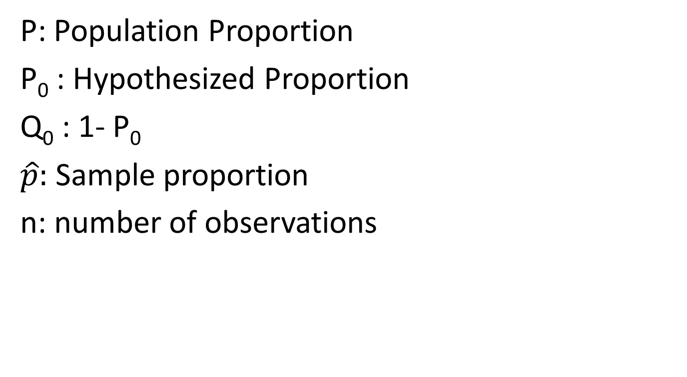
Notations
P: Population Proportion
P₀ : Hypothesized Proportion
Q₀ : 1- P₀
$\hat{p}:$ Sample proportion
n: number of observations

Slide 4


Sampling distribution of $\hat{p}$
The sample proportion is computed by dividing the frequency with which a given characteristic occurs in a sample by the number of Items in the sample.
How does a researcher use the sample proportion in analysis?

Slide 5
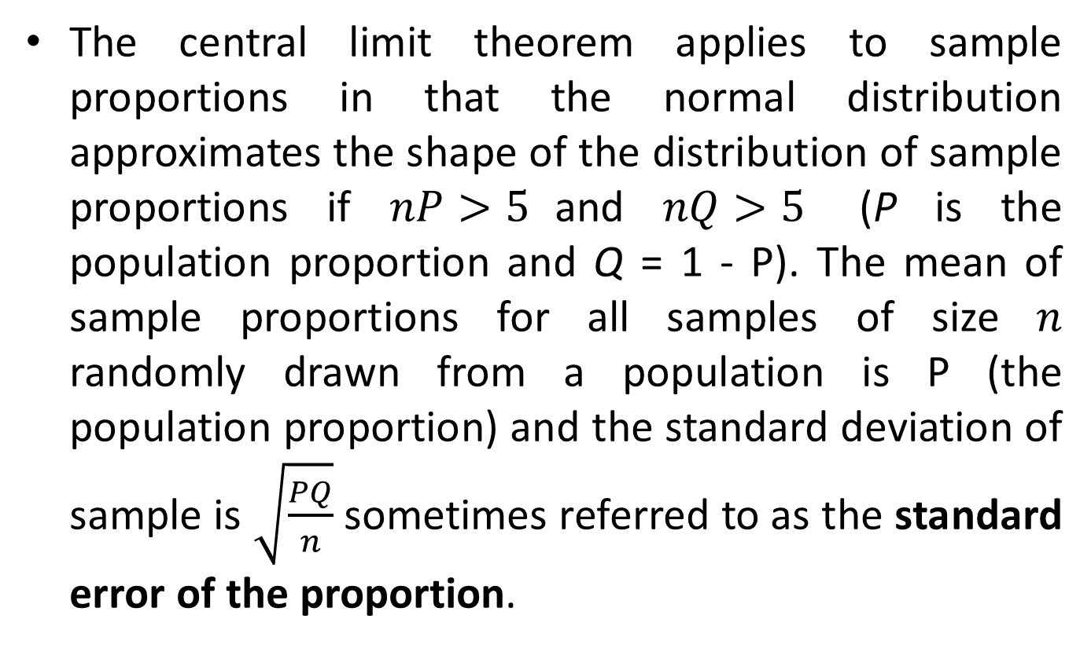

Sampling distribution of $\hat{p}$
The central limit theorem applies to sample proportions in that the normal distribution approximates the shape of the distribution of sample proportions if $nP>5$and $nQ>5$ (P is the population proportion and Q = 1 - P). The mean of sample proportions for all samples of size $n$ randomly drawn from a population is P (the population proportion) and the standard deviation of sample is $\sqrt{\frac{PQ}{n}}$ sometimes referred to as the standard error of the proportion.

Slide 6

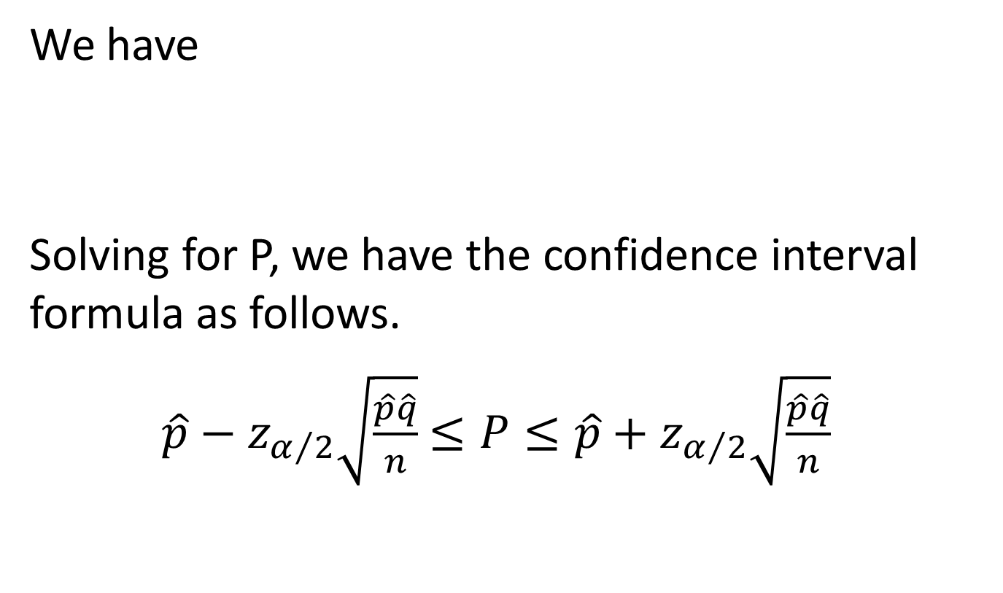
Estimating population proportion (Confidence Interval Estimation)
$$Z=\frac{\hat{p}−P}{\sqrt{\frac{\hat{p}\hat{q}}{n}}}$$
We have
Solving for P, we have the confidence interval formula as follows.
$\hat{p}−z_{α/2}\sqrt{\frac{\hat{p}\hat{q}}{n}}$ $≤P≤\hat{p}+z_{α/2}\sqrt{\frac{\hat{p}\hat{q}}{n}}$

Slide 7
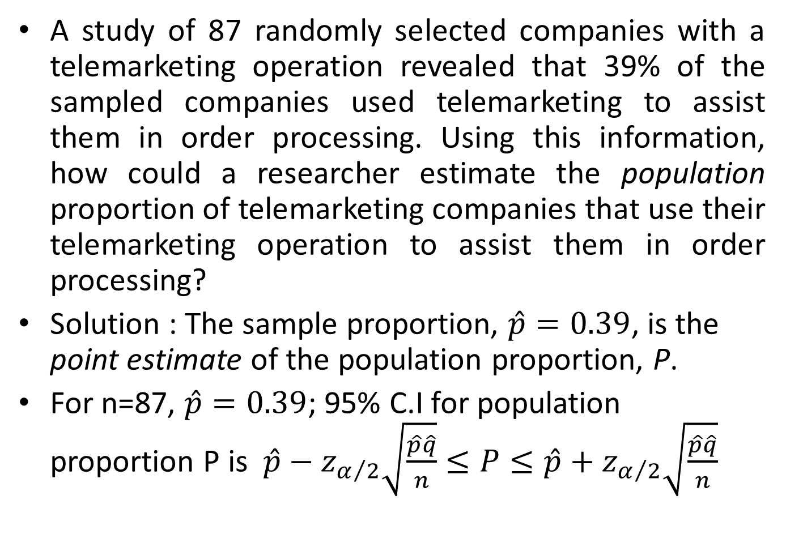
Example
A study of 87 randomly selected companies with a telemarketing operation revealed that 39% of the sampled companies used telemarketing to assist them in order processing. Using this information, how could a researcher estimate the population proportion of telemarketing companies that use their telemarketing operation to assist them in order processing?
Solution : The sample proportion, $\hat{p}=0.39$, is the point estimate of the population proportion, P.
For n=87, $\hat{p}=0.39$; 95% C.I for population proportion P is $\hat{p}−z_{α/2}\sqrt{\frac{\hat{p}\hat{q}}{n}}$ $≤P≤\hat{p}+z_{α/2}\sqrt{\frac{\hat{p}\hat{q}}{n}}$

Slide 8

Substituting and simplifying,
Interpretation: If we repeat the experiment 100 times, 95% confident that the true population proportion of telemarketing companies that use their telemarketing operation to assist them in order processing lies between 0.29 and 0.49

Slide 9

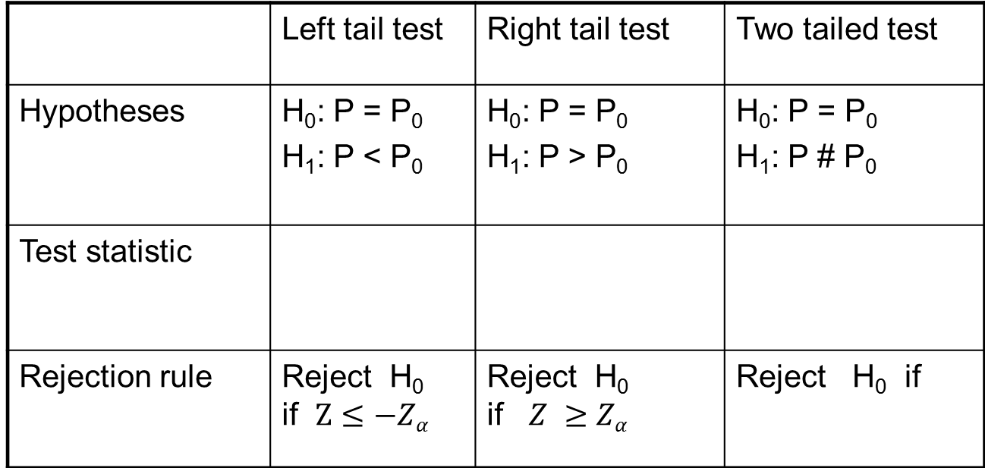

Test-3:Test for population proportion P : One sample z test for proportion
 | Left tail test | Right tail test | Two tailed test
Hypotheses | H₀: P = P₀ H₁: P < P₀ | H₀: P = P₀ H₁: P > P₀ | H₀: P = P₀ H₁: P # P₀
Test statistic
Rejection rule | Reject H₀ if $Z≤−Zα$ | Reject H₀ if $Z ≥Zα$ | Reject H₀ if
$$Z=\frac{\hat{p}−P_{0}}{\sqrt{\frac{P_{0}Q_{0}}{n}}}$$
$$Z=\frac{\hat{p}−P_{0}}{\sqrt{\frac{P_{0}Q_{0}}{n}}}$$
$$Z=\frac{\hat{p}−P_{0}}{\sqrt{\frac{P_{0}Q_{0}}{n}}}$$
Where is the critical value obtained from the standard
normal distribution

Slide 10
Numerical Problems based on single proportion
(1) A study by Hewitt Associates showed that 79% of the companies offer employees flexible scheduling. Suppose a researcher believes that in accounting firms, this figure is lower . The researcher randomly selects 415 accounting firms and through interviews determines that 303 of these firms have flexible scheduling. With 1% level of significance, does the test show enough evidence to conclude that a significantly lower proportion of accounting firms offer employees flexible scheduling?

Slide 11

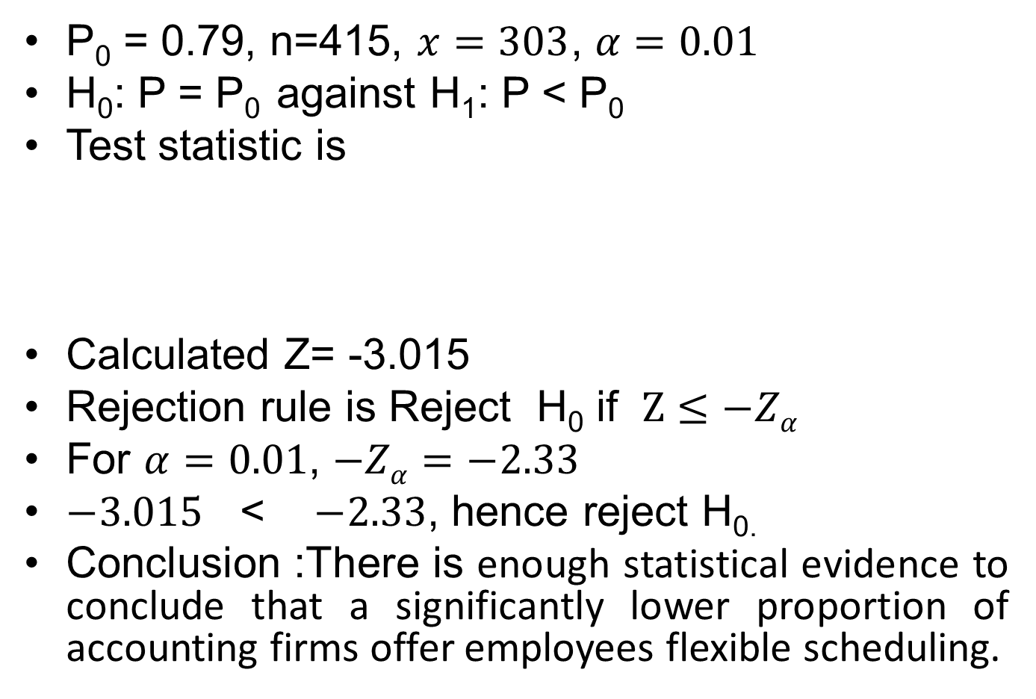
Solution
P₀ = 0.79, n=415, $x=303$, $α=0.01$
H₀: P = P₀ against H₁: P < P₀
Test statistic is
Calculated Z= -3.015
Rejection rule is Reject H₀ if $Z≤−Zα$
For $α=0.01$, $−Zα=−2.33$
$−3.015$ < $−2.33$, hence reject H_{0.}
Conclusion :There is enough statistical evidence to conclude that a significantly lower proportion of accounting firms offer employees flexible scheduling.
$$Z=\frac{\hat{p}−P_{0}}{\sqrt{\frac{P_{0}Q_{0}}{n}}}$$

Slide 12
(2) A large manufacturing company investigated the service it received from suppliers and discovered that in the past 32% of all materials shipments were received late. However the company recently installed a just-in-time system in which suppliers are linked more closely to the manufacturing process. A random sample of 120 deliveries since the just-in-time system was installed reveals that 24 deliveries were late. Use this information to test whether the proportion of late deliveries was reduced significantly.

